Slide 1
Comal Trinity Groundwater Conservation District
General Manager Report
November 18, 2024

Slide 2
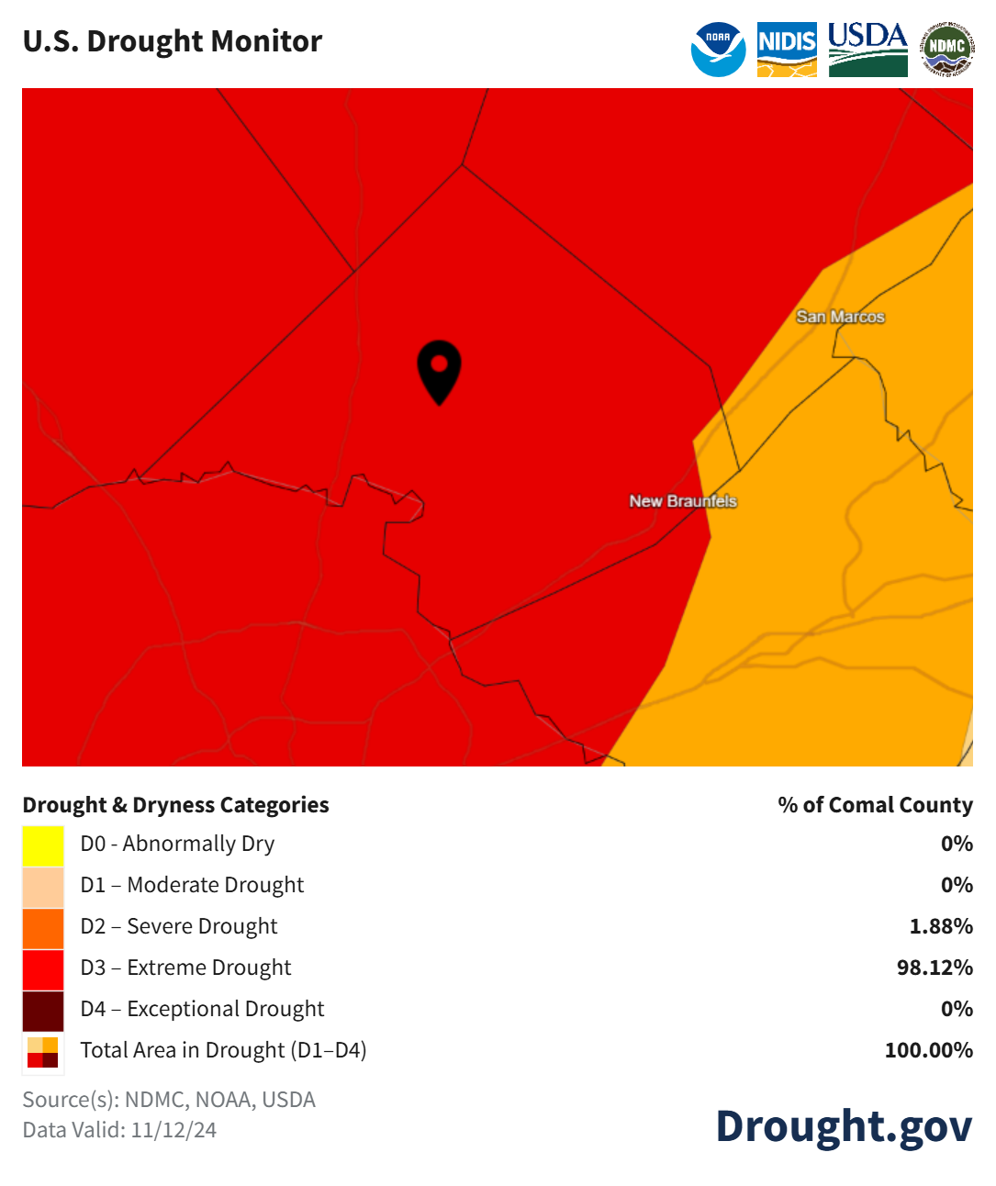
Comal County Drought Information- November 2024

Slide 3
Comal County Drought Statistics October 2024

Slide 4
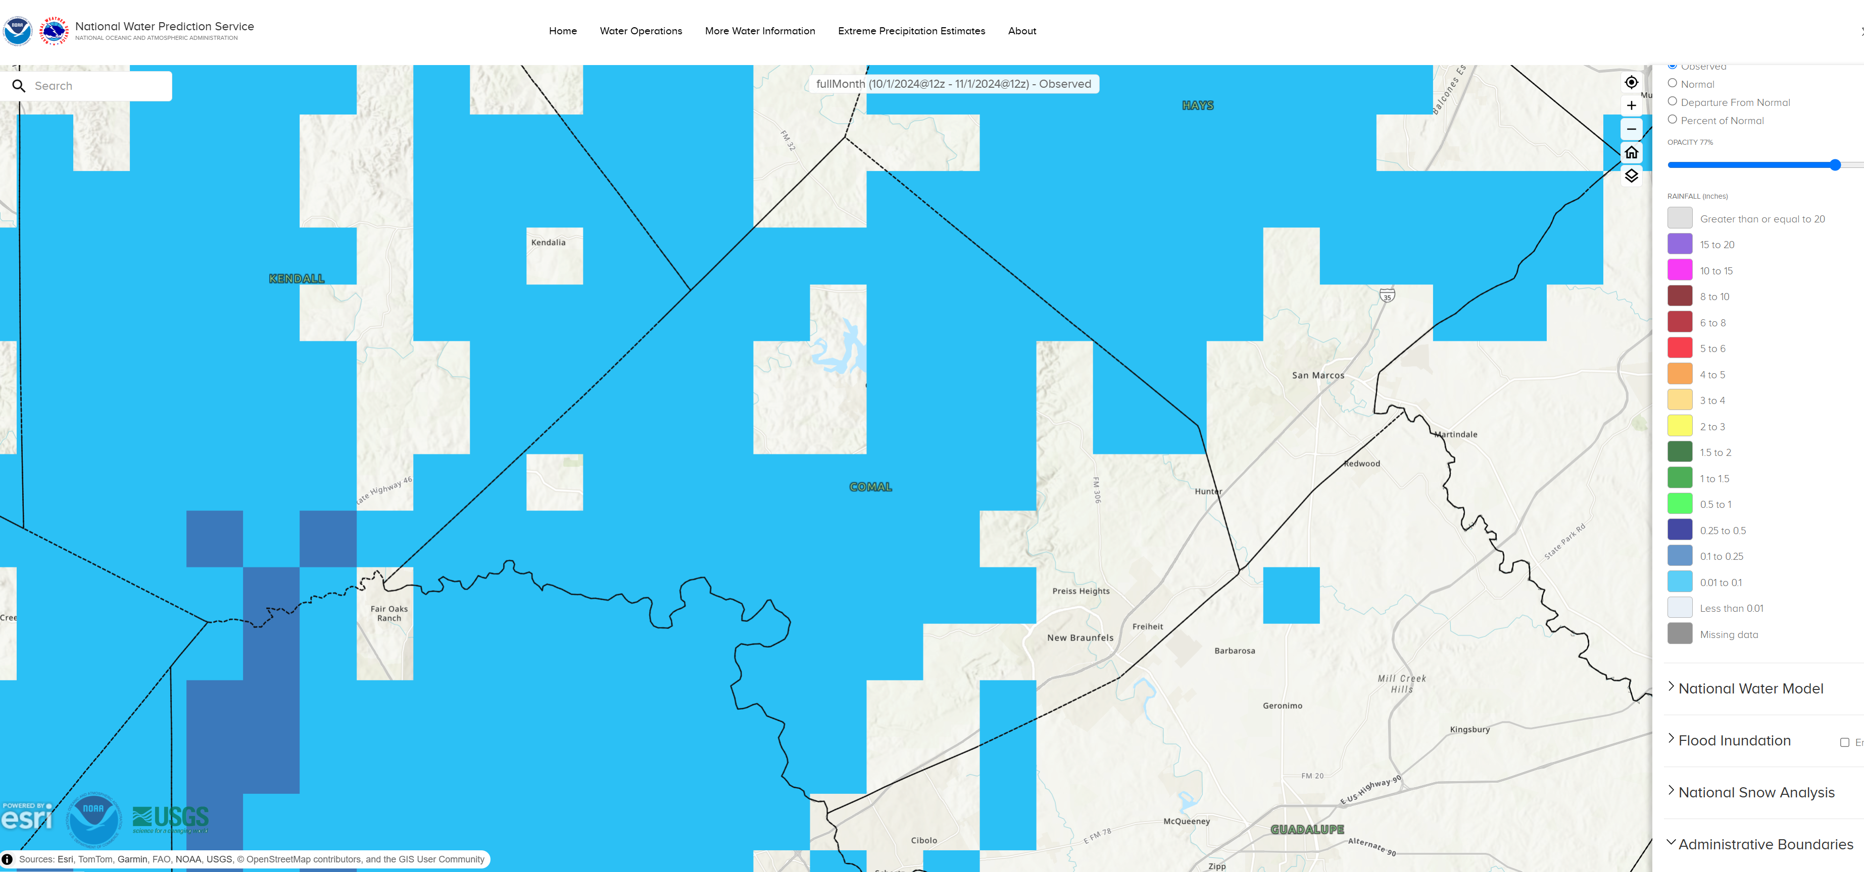
30 Day Observed Precipitation
<0.01 to 0.1 Inches

Slide 5
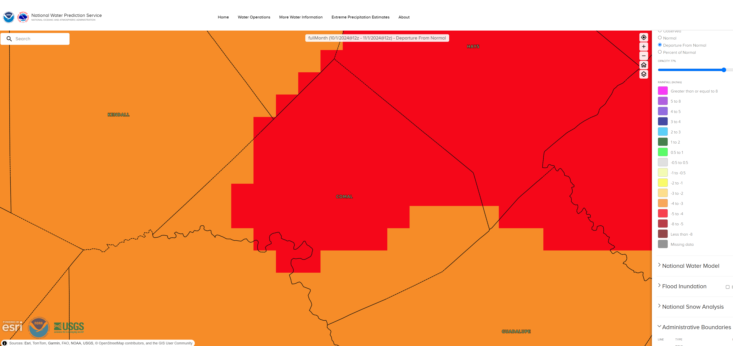
30 Day Precipitation Departure From Normal
-3.0 to -5.0 Inches

Slide 6
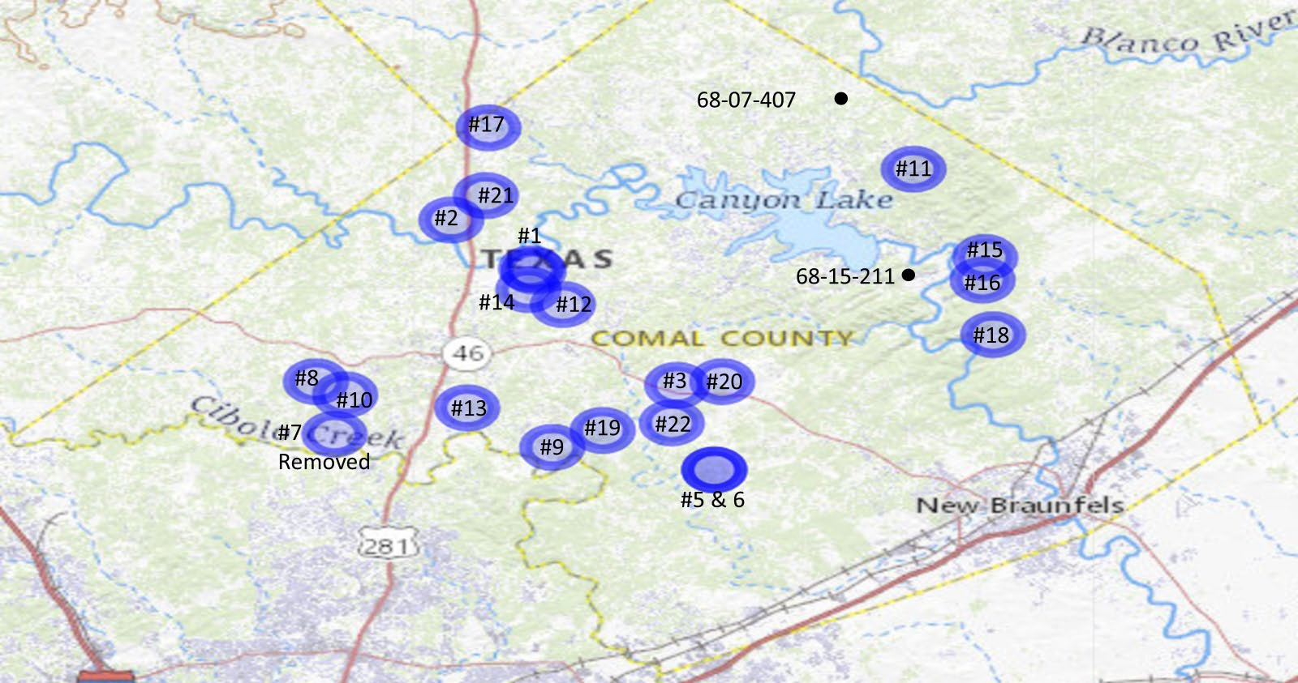
#23

Slide 7
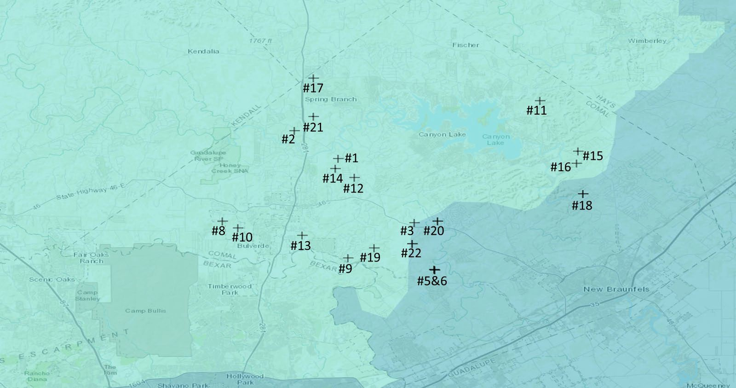
+
#23

Slide 12
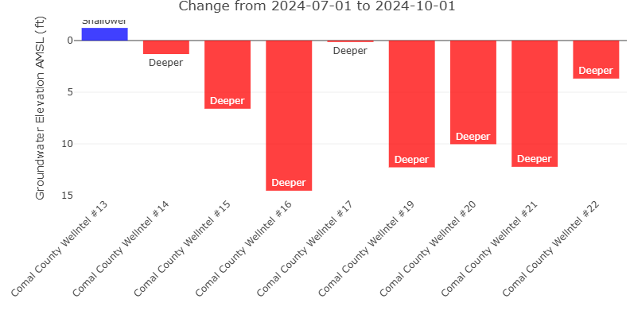

Slide 13
 |  | GMA-9 Reported | GMA-9 MAG Availability | GMA-10 Reported | GMA-10 MAG Availability
1Q2024 |  |  | 9,383 |  | 33,554
 | Gallons: | 331,387,590 |  | 563,804,513
 | Acre-ft: | 1,017 | 8,366 | 1,730 | 31,824
2Q2024
 | Gallons: | 381,988,611 |  | 604,159,420
 | Acre-ft: | 1,172 | 7,194 | 1,854 | 29,970
3Q2024
 | Gallons: | 378,103,716 |  | 740,417,333
 | Acre-ft: | 1,160 | 6,033 | 2,272 | 27,697
4Q2024
 | Gallons:
 | Acre-ft: | - | 6,033 | - | 27,697
2024 Reported | Acre-ft: | 3,350 |  | 5,857

Slide 14
Well Applications By Type
Type of Application | 1st Quarter | 2nd Quarter | 3rd Quarter | 4th Quarter | Total for Year | GMA 9 | GMA10
a) Domestic | 18 | 26 | 20 |  | 64 | 51 | 13
a)L Livestock | 0 | 1 | 1 |  | 2 | 2 | 0
a)I Domestic Landscape Irrigation | 4 | 1 | 2 |  | 7 | 7 | 0
b) < 25,000 GPD | 1 | 2 | 2 |  | 5 | 3 | 2
c) > 25,000 GPD | 0 | 1 | 2 |  | 3 | 1 | 2
d) Plugging | 2 | 4 | 2 |  | 8 | 7 | 1
e) Test Bore | 0 | 0 | 0
f) Completion of test < 25,000 GPD | 0 | 0 | 0
g) Completion of test > 25,000 GPD | 0 | 0 | 0
Geothermal | 0 | 0 | 0
Monitor well | 0 | 0 | 0

Slide 15
1st Quarter | 2nd Quarter | 3rd Quarter | 4th Quarter | Total for Year | GMA 9 | GMA10
Total Applications Received 2024 | 25 | 35 | 29 |  | 89 | 72 | 17
Total Applications Approved 2024 | 21 | 32 | 21 |  | 74
Total Borings Started in 2024 | 20 | 27 | 24 |  | 71

Slide 16
4th Quarter 2024 Update – Nov 18, 2024
Since last Meeting This quarter | 2023 | 2024 | To date
Consultations in their homes: 25 | 147 | 100 | 296
Visits to our harvesting sites 8 | 92 | 31 | 135
Rain Barrels made & delivered 9 | 25 | 22 | 47
Water Conservation articles published (4 mags): 13 | 25 | 37 | 84
Presentations/Events – (attendees - 244): 18 | 33 | 40 | 90
Wilson County Master Gardeners – Rain Harvesting – Sep 10 (18)
Mammen Library – Rain Harvesting – Sep 16 (13)
Garden Ridge Library – Rain Harvesting – Sep 19 (13)
Mystic Shores HOA – Water Use; Rain Harvesting – Sep 19 (116)
Tye Preston Library – Rain Harvesting – Sep 26 (13)
National Night Out – Trinity Aquifer Status – Oct 1 (45)
Mystic Shores Men’s Club – Rain Harvesting – Oct 12 (26)

Slide 17
Upcoming presentations (continued):
4th Quarter 2024 Update – Nov 18, 2024
Comal Republican Women’s Group – Rain Harvesting – Nov 20 (60)
Bexar County Master Gardeners – Rain Barrels – Jan 13 (25)
Bexar County Master Gardeners – Wicking Gardening – Jan 13 (25)
Bexar County Master Gardeners – Rain Harvesting – Jan 13 (25)
Kingsbury Development Committee – Rain Harvesting – Jan 14 (60)
Gonzales Master Gardeners – Rain Barrels – Jan 21 (35)
Gonzales Master Gardeners – Wicking Gardening – Jan 21 (35)
Gonzales Master Gardeners – Rain Harvesting – Jan 21 (35)
Village West HOA in Canyon Lake – Rain Harvesting – Feb 12 (50)
Comal Master Gardeners – Rain Barrels – Apr 9 (30)
Guadalupe Master Gardeners – Rain Barrels – Apr 15 (35)
Guadalupe Master Gardeners – Wicking Gardening – Apr 15 (35)
Guadalupe Master Gardeners – Rain Harvesting – Apr 15 (35)

Slide 18
Upcoming Presentations:
4th Quarter 2024 Update – Nov 18, 2024
Comal Master Gardeners – Wicking buckets – Apr 9 (30)
Comal Master Gardeners – Rain Harvesting – Apr 9 (30)
Hidden Trails Garden Group – Xeriscape – TBD (15)
Guadalupe Master Gardeners – Rain Barrels – Apr 15 (35)
Guadalupe Master Gardeners – Wicking Gardening – Apr 15 (35)
Guadalupe Master Gardeners – Rain Harvesting – Apr 15 (35)
Rain Barrels made & delivered – (9) RainBee public service consultants:
Dr. Steven Grainger
Dr. Larry Sunn
Joe DiPasquale
Chuck McCollum
Reggie Coots

